Slide 1
Fraudulent Claim Detection
Astha Bansal
Ashwini Agalave

Slide 2
Problem Statement
Determine if a given Auto Insurance Claim is fraudulent or not for a given set of features. Develop a predictive model for the same.

Slide 3
Potential Business Problems
Identifying fraudulent claims is important for any Insurance Company as they would not want to pay out on claims that are not legal
For Auto Insurance, fraudulent claims may arise due to someone claiming for damages for an accident, when no accident might have taken place
Traditionally, insurance companies have a claim investigation team to investigate claims and determine whether or not they are fraudulent.
However, with the increase in power of computing and advanced analytics, insurance companies are trying to come up with automated solutions to determine if a claim is fraudulent or not as the previous methods are prone to errors.

Slide 4
Why Solve this problem
Identify the circumstances which lead to fraudulent claims
Reduce reliance on human investigators to determine whether a claim is fraudulent or not
Correctly identify legal claims to ensure payout to rightful policyholders
May also help to determine what type of policyholders the company should avoid.

Slide 5
Features of the Dataset
1000 Datapoints
38 features:
13 numerical features
25 categorical features
One Target Variable: Fraud_Reported
Yes – 247 Count
No – 753 Count
Target variable demonstrates High Class Imbalance. Important to take care of this during modelling.
Dataset split into Train and Test set for modelling purpose. Train set had 800 datapoints. Test set had 200 datapoints.

Slide 6
Evaluation Metric
The evaluation metric for this project is precision and recall and ROC AUC Score.
For business usecase, it is important to identify false positives and true negatives, so recall is to be given more importance.

Slide 7
Data Cleaning and Preprocessing

Slide 8
Changing dtypes and Dropping columns with Unique Values
Needed to change dtype of certain columns from numerical to categorical as they were categorical features by nature:
Number of Vehicles Involved
Number of Bodily Injuries
Number of Witnesses
Decided to drop 5 columns as had too many unique values, did not give any useful insights:
Policy Number
Policy Bind Date
Insured Zip
Incident Date
Incident Location

Slide 9
Imputation of Missing Values
Three columns had ‘?’ (missing values):
Collision Type
Property Damage
Police Report Available
Imputed missing values using a KNNImuputer (K = 5)

Slide 10
Label Encoding of Categorical Features
Categorical features were label encoded before inputting into the model.
Did not one hot encode because of use of tree- based models.

Slide 11
Exploratory Data Analysis

Slide 12
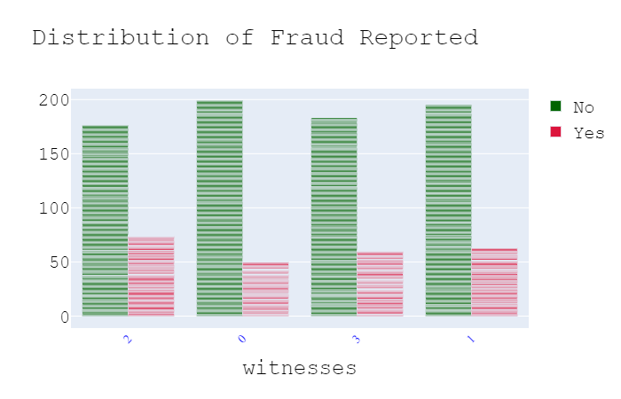
Number Of Witnesses gives some information
Even the presence of one witness increase the chances of detecting a claim as fraudulent.
Out of 247 fraudulent claims, 197 claims had atleast one witness present

Slide 13
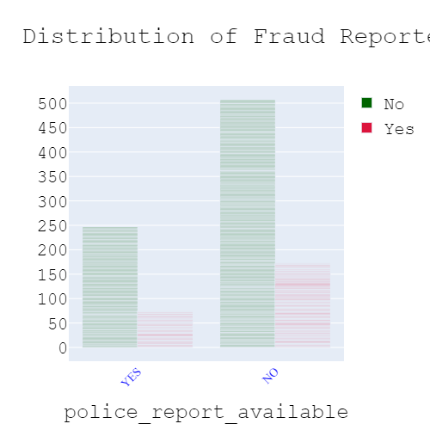
Police Report Is Important
Availability of police report reduces the chances of fraudulent claims, although fewer cases actually have a police report available.
Increase in number of datapoints would help to determine a more clear relationship between fraudulent claims and the availability of police reports.

Slide 14
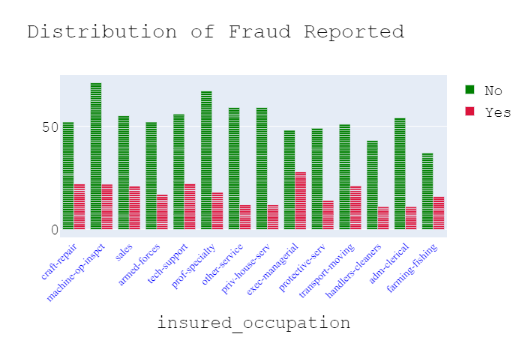
Occupations Reveal an Interesting Fact
People who mentioned their occupation as Exec – Managers have the most likelihood of making a fraudulent claim
37% of claims made by this category was fraudulent.

Slide 15
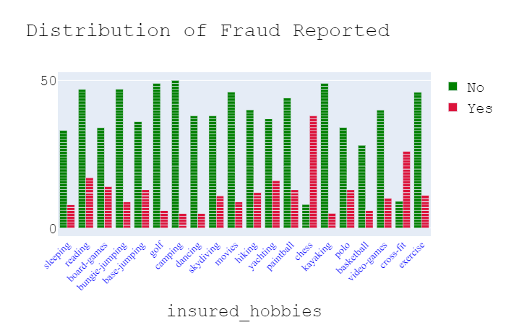
Hobbies seems to be an important question to ask policyholders
People who play chess and practice cross-fit are actually more likely to make a fraudulent claim than a rightful claim.
For both hobbies, people are more than 4 times more likely to report a fraudulent claims.

Slide 16
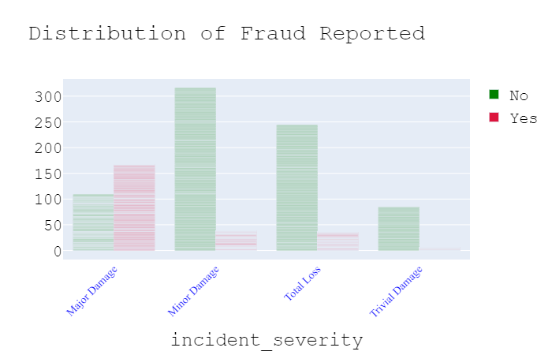
Incident may not be so severe
Major Damage is reported fraudulently more often.
This is what would be expected. People claiming for minor damage tend to add other previous damages that would not actually be part of the incident for which the claim has been made.

Slide 17
Feature Selection

Slide 18
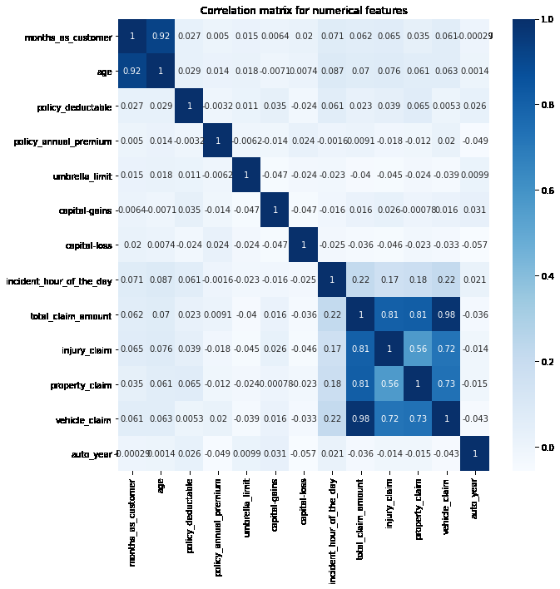
Correlation Amongst Numerical Features
The following heatmap shows high correlation amongst the following columns:
Age and Months as customer
Total Claim Amount with its individual constituents. (Injury, Property, Vehicle)
Age and the individual Constituents were dropped from the dataset.

Slide 19
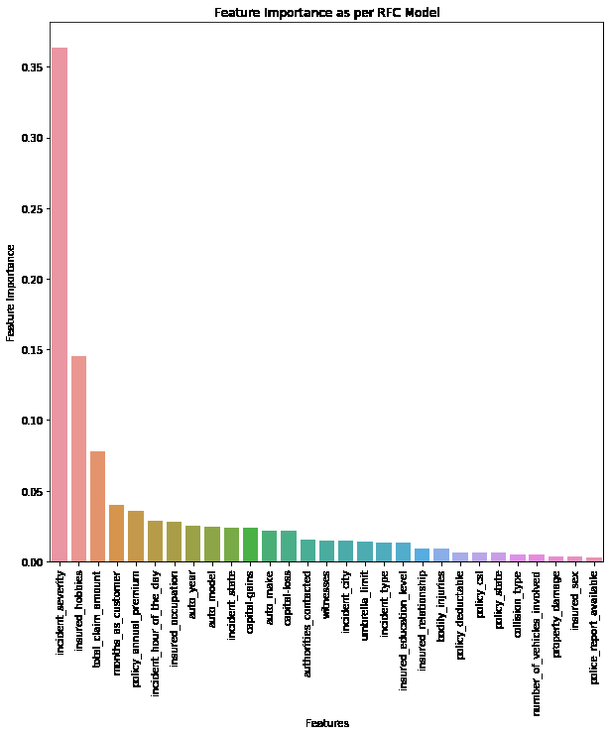
Feature Importance as per RFC
As per RFC, incident severity and insured hobbies are the most important features. This was evidenced during EDA. This is followed by total claim amount.
However, choosing just three features does not allow the model to separate well between the classes
Decided to drop features with feature importance of less than 1%. This gives us 19 features.

Slide 20
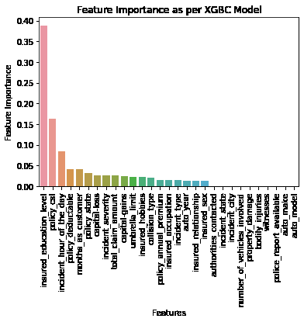
Feature Importance as per XGBC
As per Xgbc, insured education level and policy_csl are the most important features.. This is followed by incident hour of the day.
However, choosing just three features does not allow the model to separate well between the classes
Decided to drop features with feature importance of less than 1%. This gives us 19 features.

Slide 21
Models and Approaches

Slide 22
Models Used
After removing correlated features and features with unique values, we have 30 features in the dataset:
9 Numerical Features
21 Categorical Features
Predictive Model used is RandomForestClassifier and XGBoostClassifier
Also tried using GradientBoostingClassifier, however above models gave superior performance
RandomForestClassifier gave best performance, so results for that have been shown.

Slide 23
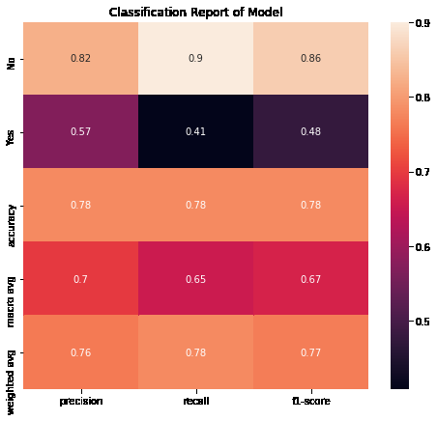
Base model performance
The Base model performed fairly well on rightful claims, but not so great on the fraudulent claims.
This shows the need to hypertune the model, by giving more weight to the underrepresented class. Could also be the case of overfitting on training dataset.

Slide 24
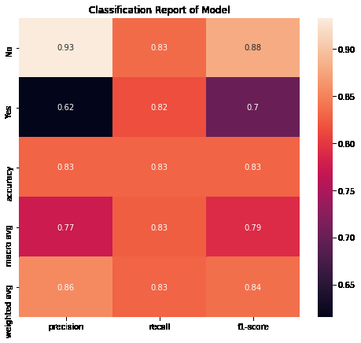
Model Tuning
Model performance has vastly improved because of hyperparameter tuning.
Recall for both classes is above 80%.
From a business point of view, recall of fraudulent class should be one, so still room for improvement.

Slide 25

Model Performance with important features
Model performance with selection of only important features has improved slightly more
F1-Score has increased from 0.84 to 0.85

Slide 26
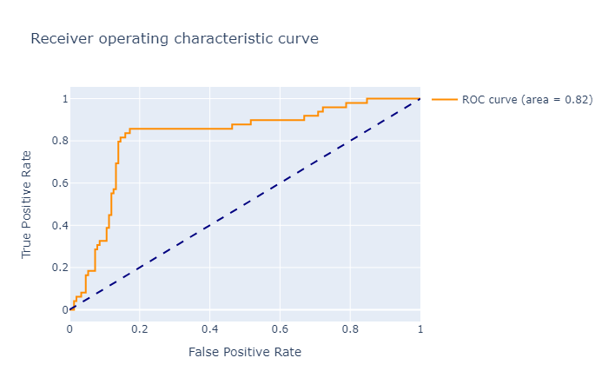
ROC AUC Curve
ROC AUC Curve shows how well the model has been able to separate out the classes
ROC AUC Score of 0.82 shows the model has done a good job, but there is room for improvement.

Slide 27
Insights and Business Decisions
Claims to be targeted:
Having atleast one witness
Insured has a hobby of Chess or CrossFit
Insureds listing their occupation as Exec- Managers
Insureds reporting claims for major damage
Claim amount and insured education level are also important features as evidenced by model feature importance
There is also a need to increase police reports on claims made as it can serve as an initial screen for fraudulent claims
Also prepared an interactive Dashboard using Dash and plotly showing the Countplots for categorical features

Slide 28
Future Steps
Time permitting, following additional actions could have been taken:
Use of different imputers for missing values to see if any other gives superior performance such as iterative imputer
Use of different models like LogisticRegression and SVM to see how dataset responds to these models
Application of sampling techniques to handle class imbalance such as SMOTE, random oversampling
Identify unique set of features that might always be leading to fraudulent claims.
Use of pipeline to streamline the modelling process
Adding features to dashboard and make it more user-friendly
There is a need to capture more data as not many useful business insights can be drawn from 1000 datapoints. More data, better results

